Slide 1
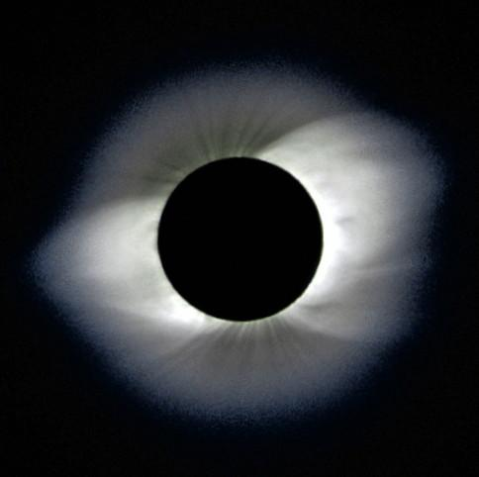
Lec 6: Science from Eclipses
© Gerard Williger 2023 U Louisville
Science from past eclipses
Science from current eclipses
Mar. 9, 1997 Eclipse, NE Asia, photo by Glenn Schneider

Slide 2
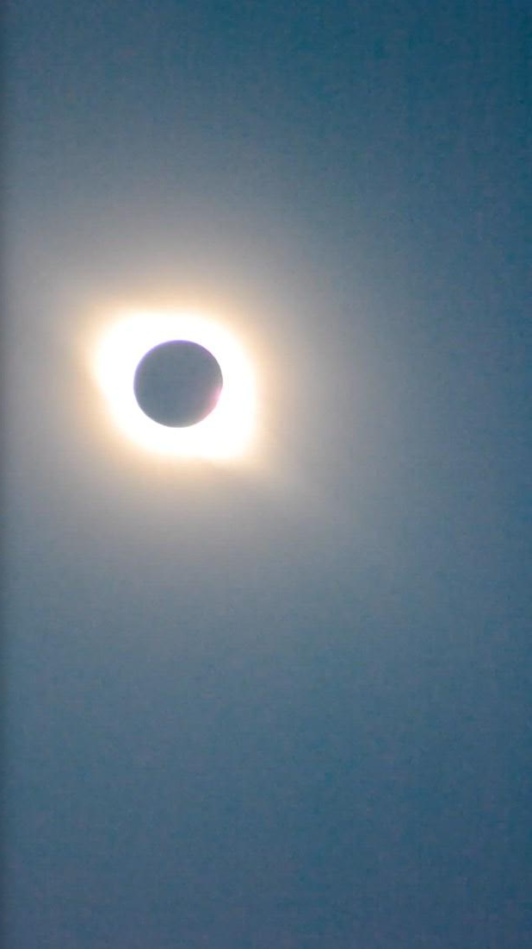
6.1 Science from Past Eclipses
© Gerard Williger 2023 U Louisville
Note: Earth is ONLY place in solar system where a moon JUST blocks sun’s disk
Due to coincidence of Moon’s, Sun’s sizes + distances from Earth
Eclipses allow us to study Sun’s CORONA and PROMINENCES in detail!
Chile, July 2, 2019, Washington Post

Slide 3
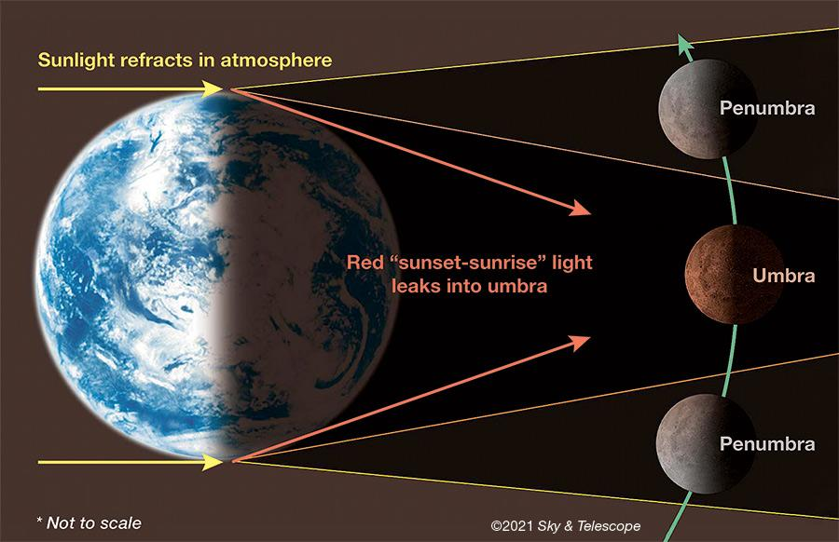
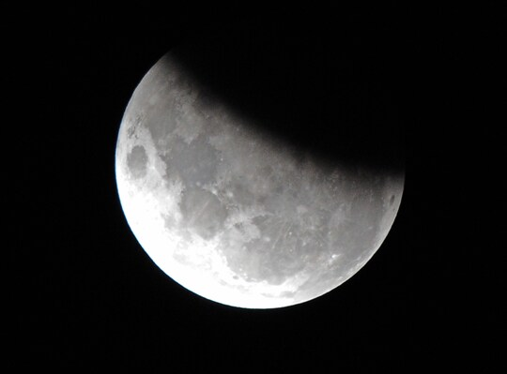
c. 500-100 BC: Earth’s Size; Longitude
© Gerard Williger 2023 U Louisville
In ancient world, start/end of a lunar eclipse was seen at same time by entire night side of Earth
Latitude easy to calculate by Sun’s elevation; Longitude HARD
Lunar eclipses: provided way to observe Moon’s position at same time by observers in 2 different places
Earth’s round shadow → Earth is round, 4x bigger than Moon, Moon is 30 Earth diameters away
Local time difference between observers gave
1) SIZE of Earth
2) Difference in LONGITUDE
Used by ancient Greeks (Eratosthenes, Hipparchus, Aristarchus)
Not to scale!
Lunar eclipse, June 4, 2012, Sydney (Wash. Post)

Slide 4

Halo During Solar Eclipse
© Gerard Williger 2023 U Louisville
In past, glow around Sun during eclipse was thought to be sunlight reflecting off Moon’s atmosphere
BUT Moon has NO atmosphere
French watercolor, late 17th cent., eclipse of Apr. 30, 1688, French Jesuits in Siam, artist unknown

Slide 5
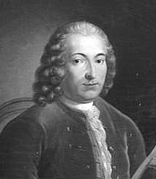
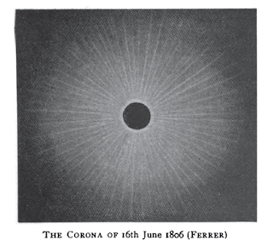
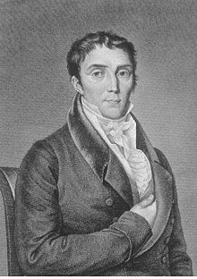
I-May 22, 1724 Eclipse: Sun’s Corona
© Gerard Williger 2023 U Louisville
Giacomo Maraldi (Italy/France) concluded the glow around the Moon was from the Sun
Term “Corona” from José Joaquin de Ferrer (Spain), after June 16, 1806 eclipse in Kinderhook NY
Giacomo Maraldi (1665-1729)
José Joaquin de Ferrer (1763-1818)

Slide 6
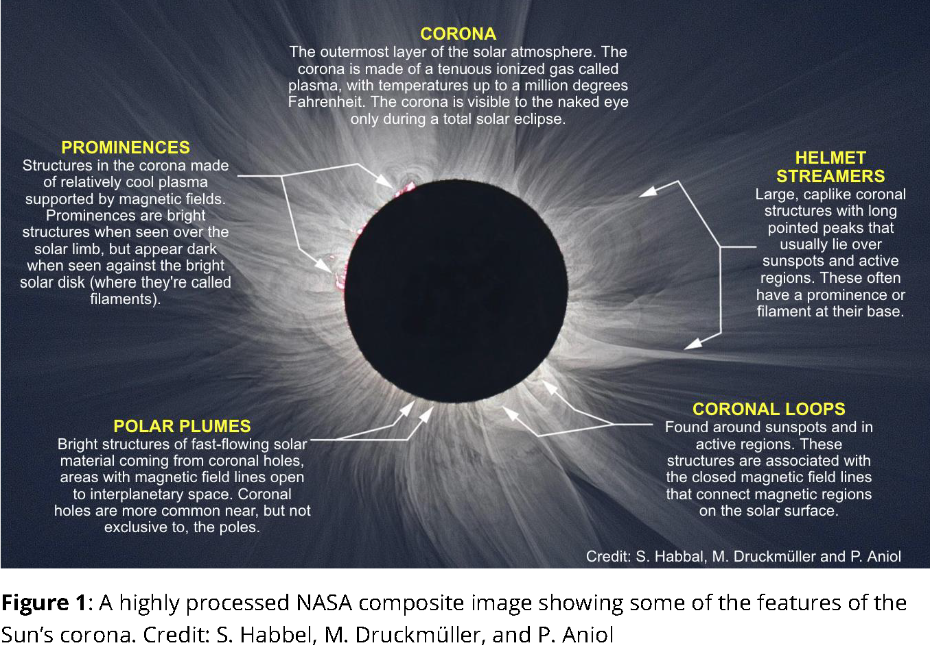
Sun’s Corona
© Gerard Williger 2023 U Louisville
Source: https://mynasadata.larc.nasa.gov/mini-lessonactivity/what-suns-corona

Slide 7
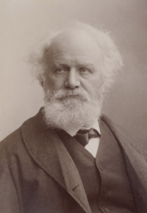
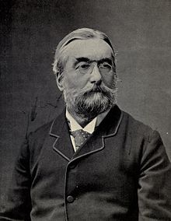
II-Aug 18, 1868: Discovery of Helium
© Gerard Williger 2023 U Louisville
Eclipse through Middle East, India, Siam
Pierre Janssen (France) to Madras, Brit. India
1859: Gustav Kirchoff proposed lines in solar spectrum made by elements in Sun
1868: Janssen used spectroscopy to see unidentified bright yellow line in prominences
1868: Also seen by Norman Lockyer (UK) through London fog, named helium
1882: Detected in lava on Earth by Luigi Palmieri (Italy)
1895: Isolated in lab by Sir William Ramsay (UK), Theodor Cleve & Abraham Langlet (Sweden)
Pierre (Jules) Janssen, 1824-1907
Sir J. Norman Lockyer, 1836-1920

Slide 8
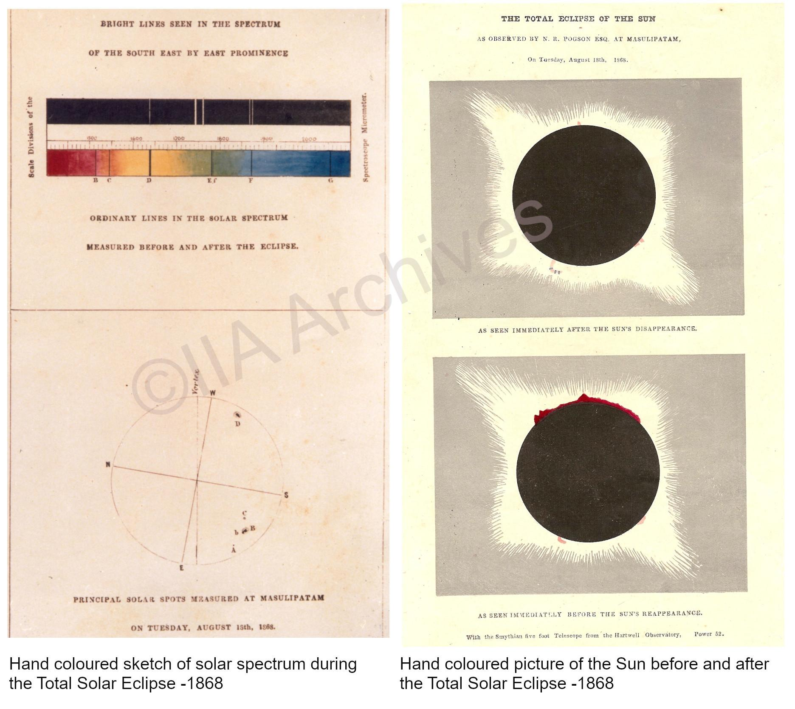
Spectrum, Corona from 1868
© Gerard Williger 2023 U Louisville
helium: wavelength 587.49 nanometers
Previously known: sodium “D” lines: 589 and 590 nanometers
3’ video - discovery of helium

Slide 9
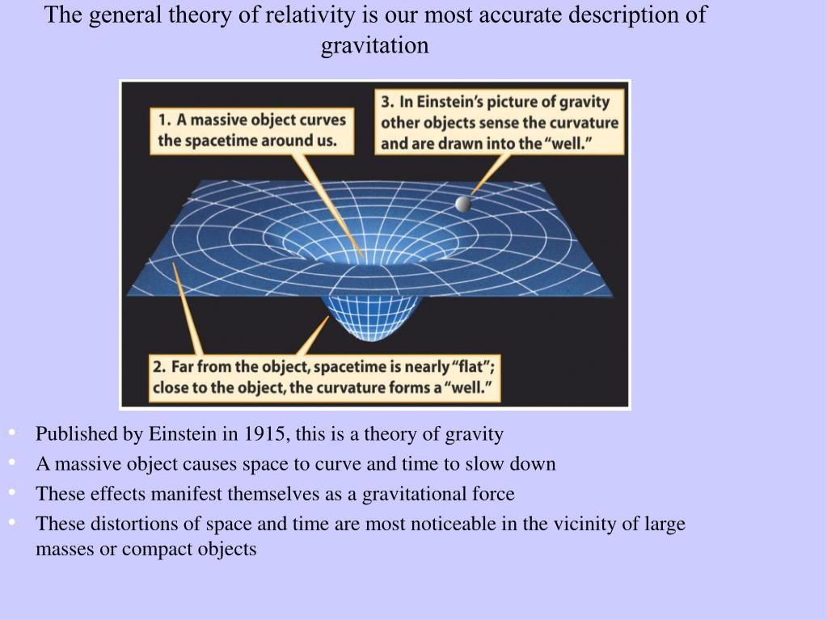
1911-15 New Theory: General Relativity (GR)
© Gerard Williger 2023 U Louisville
5.7’ GR video FYI – Wiki Channel
1911: Einstein first published a prediction of the deflection of starlight by gravity – but his theory was yet incomplete.

Slide 10
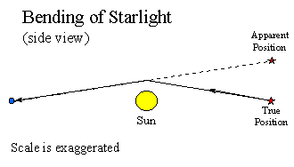
III-An Eclipse: Chance to Test General Relativity
© Gerard Williger 2023 U Louisville
Einstein 1911: predicted deflection 0.83 arcsec on limb (edge) of Sun
0.83 arcsec
Star
Angle like thickness of a hair at 30 yds (27m)
Earth
Rick Pogge, Ohio State U

Slide 11
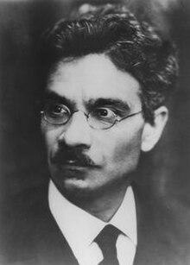
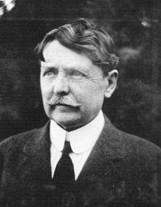
1st try: Oct 10, 1912 - Brazil
© Gerard Williger 2023 U Louisville
Oct 1911, 26 year old Erwin Finlay-Freundlich (Germany) asked Charles Perrine (American; Dir. Argentine Nat’l Obs.) to photograph light deflection
W.W. Campbell (USA, Dir. Lick Obs., CA) loaned special camera lenses
Torrential rain!
29 year old Arthur Eddington (UK) saw Perrine in Brazil, may have discussed light deflection
Erwin Finlay-Freundlich (1885-1964)
Charles Perrine (1867-1951)

Slide 12

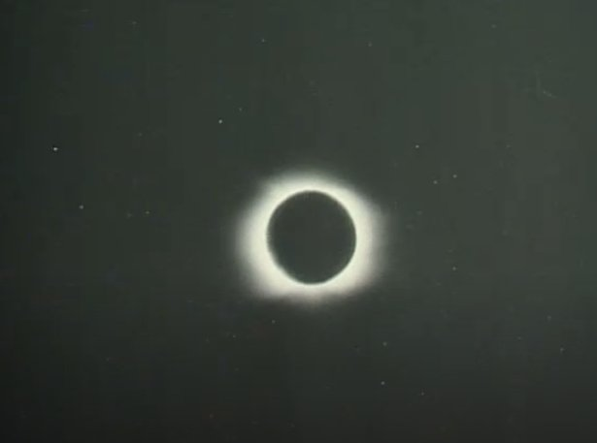
2nd try: Aug 21, 1914 - Crimea
© Gerard Williger 2023 U Louisville
3 expeditions, from Argentina, Germany, US
World War I started Aug 1
German astronomers forced to return home or were taken prisoner – including Freundlich (quickly exchanged)
Clouds prevented other observations
Verdun
1914 eclipse, Filmarkivet: Solfoermoerkelse 1914

Slide 13
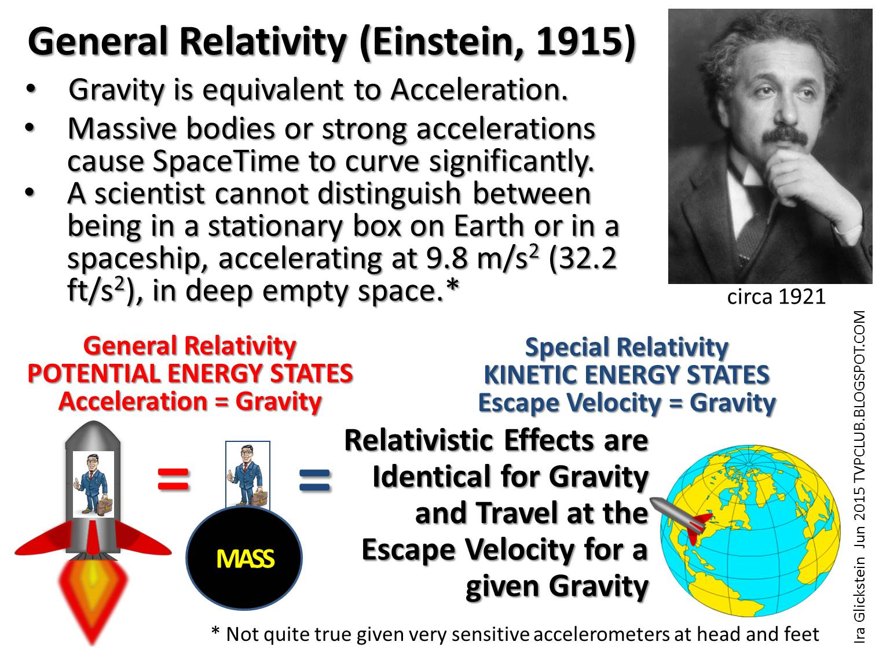
Einstein 1915: corrected calculation to 1.75 arcsec deflection at limb of Sun – so earlier rain/clouds would have proven him wrong!
© Gerard Williger 2023 U Louisville

Slide 14
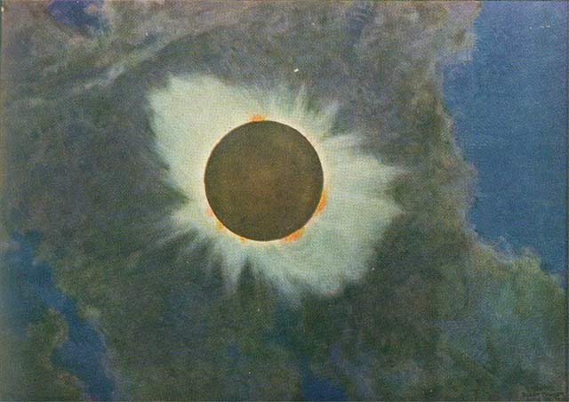
3rd Try: June 8, 1918
© Gerard Williger 2023 U Louisville
Last US coast-to-coast Eclipse before 2017
US Naval Observatory sent team to Baker City OR (got $3500 from Congress = $71,000 in 2023)
Preparations began 1917
Got railway discounts!
Another location also foiled – lacked proper equipment
Painting by Howard Russell Butler, 1918 eclipse
Thin clouds – enough to block stars!

Slide 15
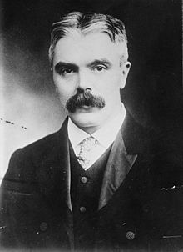
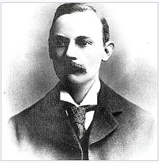
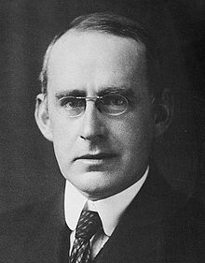
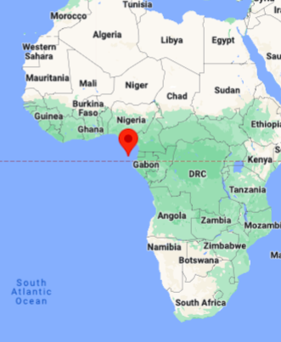
4th Try: May 29, 1919
© Gerard Williger 2023 U Louisville
British team:
Sir Frank W Dyson (UK) proposed/directed eclipse expedition
Arthur Eddington went to Principe, took classic photo
Satisfied exemption from UK draft (Quaker)
Andrew Crommelin went to Sobral, Brazil
also made good measurements
Andrew C.C. Crommelin (1865-1939)
Sir Frank W Dyson (1868-1939), Lib. of Congress
Sir Arthur Eddington (1882-1944)
2’ video on 1919 eclipse – NOVA PBS
Principe

Slide 16
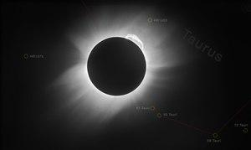
Scan, Landessternwarte, Heidelberg
© Gerard Williger 2023 U Louisville
From Eddington expedition, Sun in front of Hyades cluster (in Taurus)

Slide 17
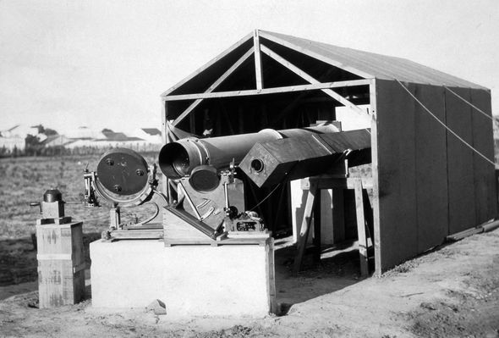
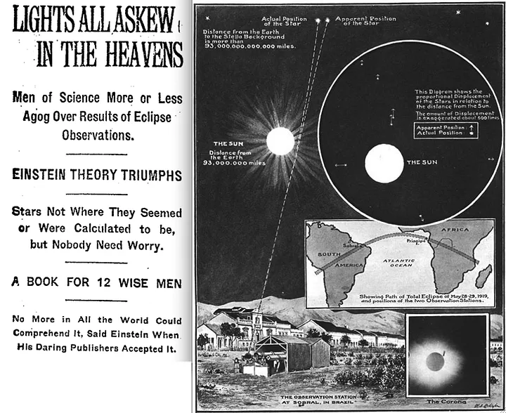
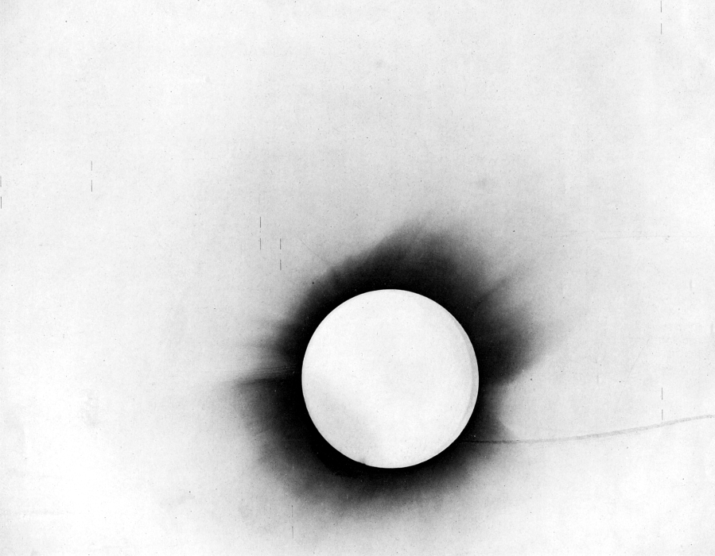
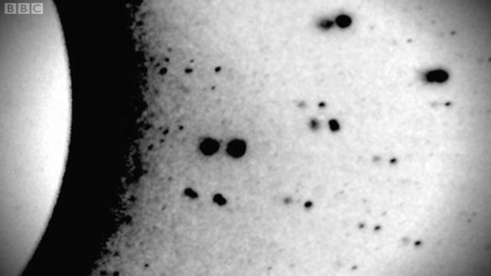
Relativity Confirmed: global news!
© Gerard Williger 2023 U Louisville
New York Times, Nov 10, 1919
Illustrated London News, Nov. 22, 1919
Crommelin expedition observing set-up, Sobral, Brazil, May 29, 1919 (Image: Getty)
Star positions slightly changed by sun’s gravity, confirming Einstein’s theory of general relativity. Deflec-tion is 1.75 arcseconds – a grain of salt 90 feet away. Photo by Arthur Eddington, 1919 eclipse, Cape Verde Islands

Slide 18
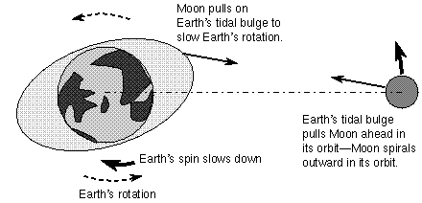
IV – Historical Eclipses: Earth’s Rotation, Moon’s Orbit History, Changes to Corona
© Gerard Williger 2023 U Louisville
Eclipses depend on Earth’s and Moon’s ORBITS
Which day they occur depends on
1) EARTH’S ROTATION (slows down from Moon’s tides; changes with surface ice distribution + earthquakes)
2) MOON’S ORBIT (reasonably well known)
Knowing the date/time of eclipses in the past
→ helps us track Earth’s rotation over centuries or millennia
Changes in Sun’s corona (especially with respect to sunspot activity) noted in historical descriptions
Glenn Schneider, Mar 9, 1997 eclipse

Slide 19
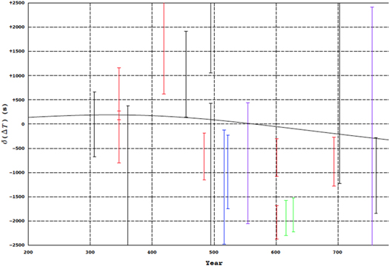
Change in Earth’s Rotation, 200-800 AD
© Gerard Williger 2023 U Louisville
+2500 sec
Variation in time by year (seconds)
+2500 sec
Year (AD): 200 300 400 500 600 700
Hayakawa et al. 2022, Publ Astron Soc Pacific, 134, 094401, from Byzantine records of 5 eclipses, 4th-7th centuries

Slide 20
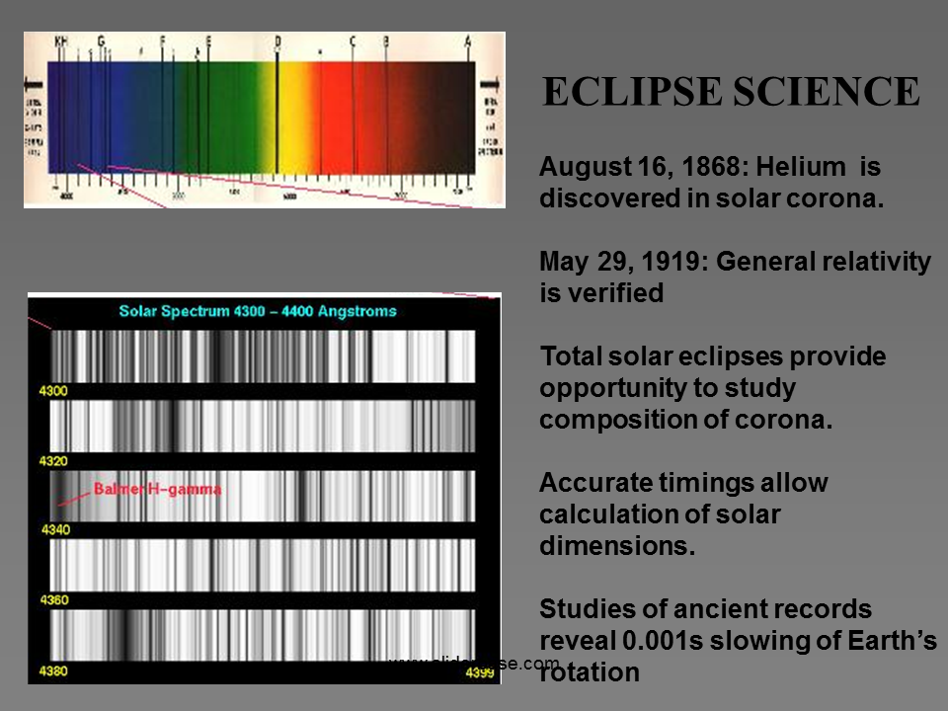
Summary: Historical Eclipse Science
© Gerard Williger 2023 U Louisville
ECLIPSE SCIENCE
May 22, 1724: Corona is part of Sun, not Moon
plus other changes

Slide 21
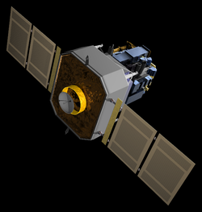

6.2 Modern Eclipse Science
© Gerard Williger 2023 U Louisville
Many solar observation satellites – but LIMITED in image and spectral resolution = detail
Ground-based equipment can be updated faster than satellites
Telescopes on ground can be bigger → higher resolution for images, spectra
Solar and Heliospheric Observatory, NASA + ESA, launched 1995
4m diameter Daniel K Inouye Solar Telescope, Nat’l Solar Obs., Hawaii, 1st light 2019

Slide 22
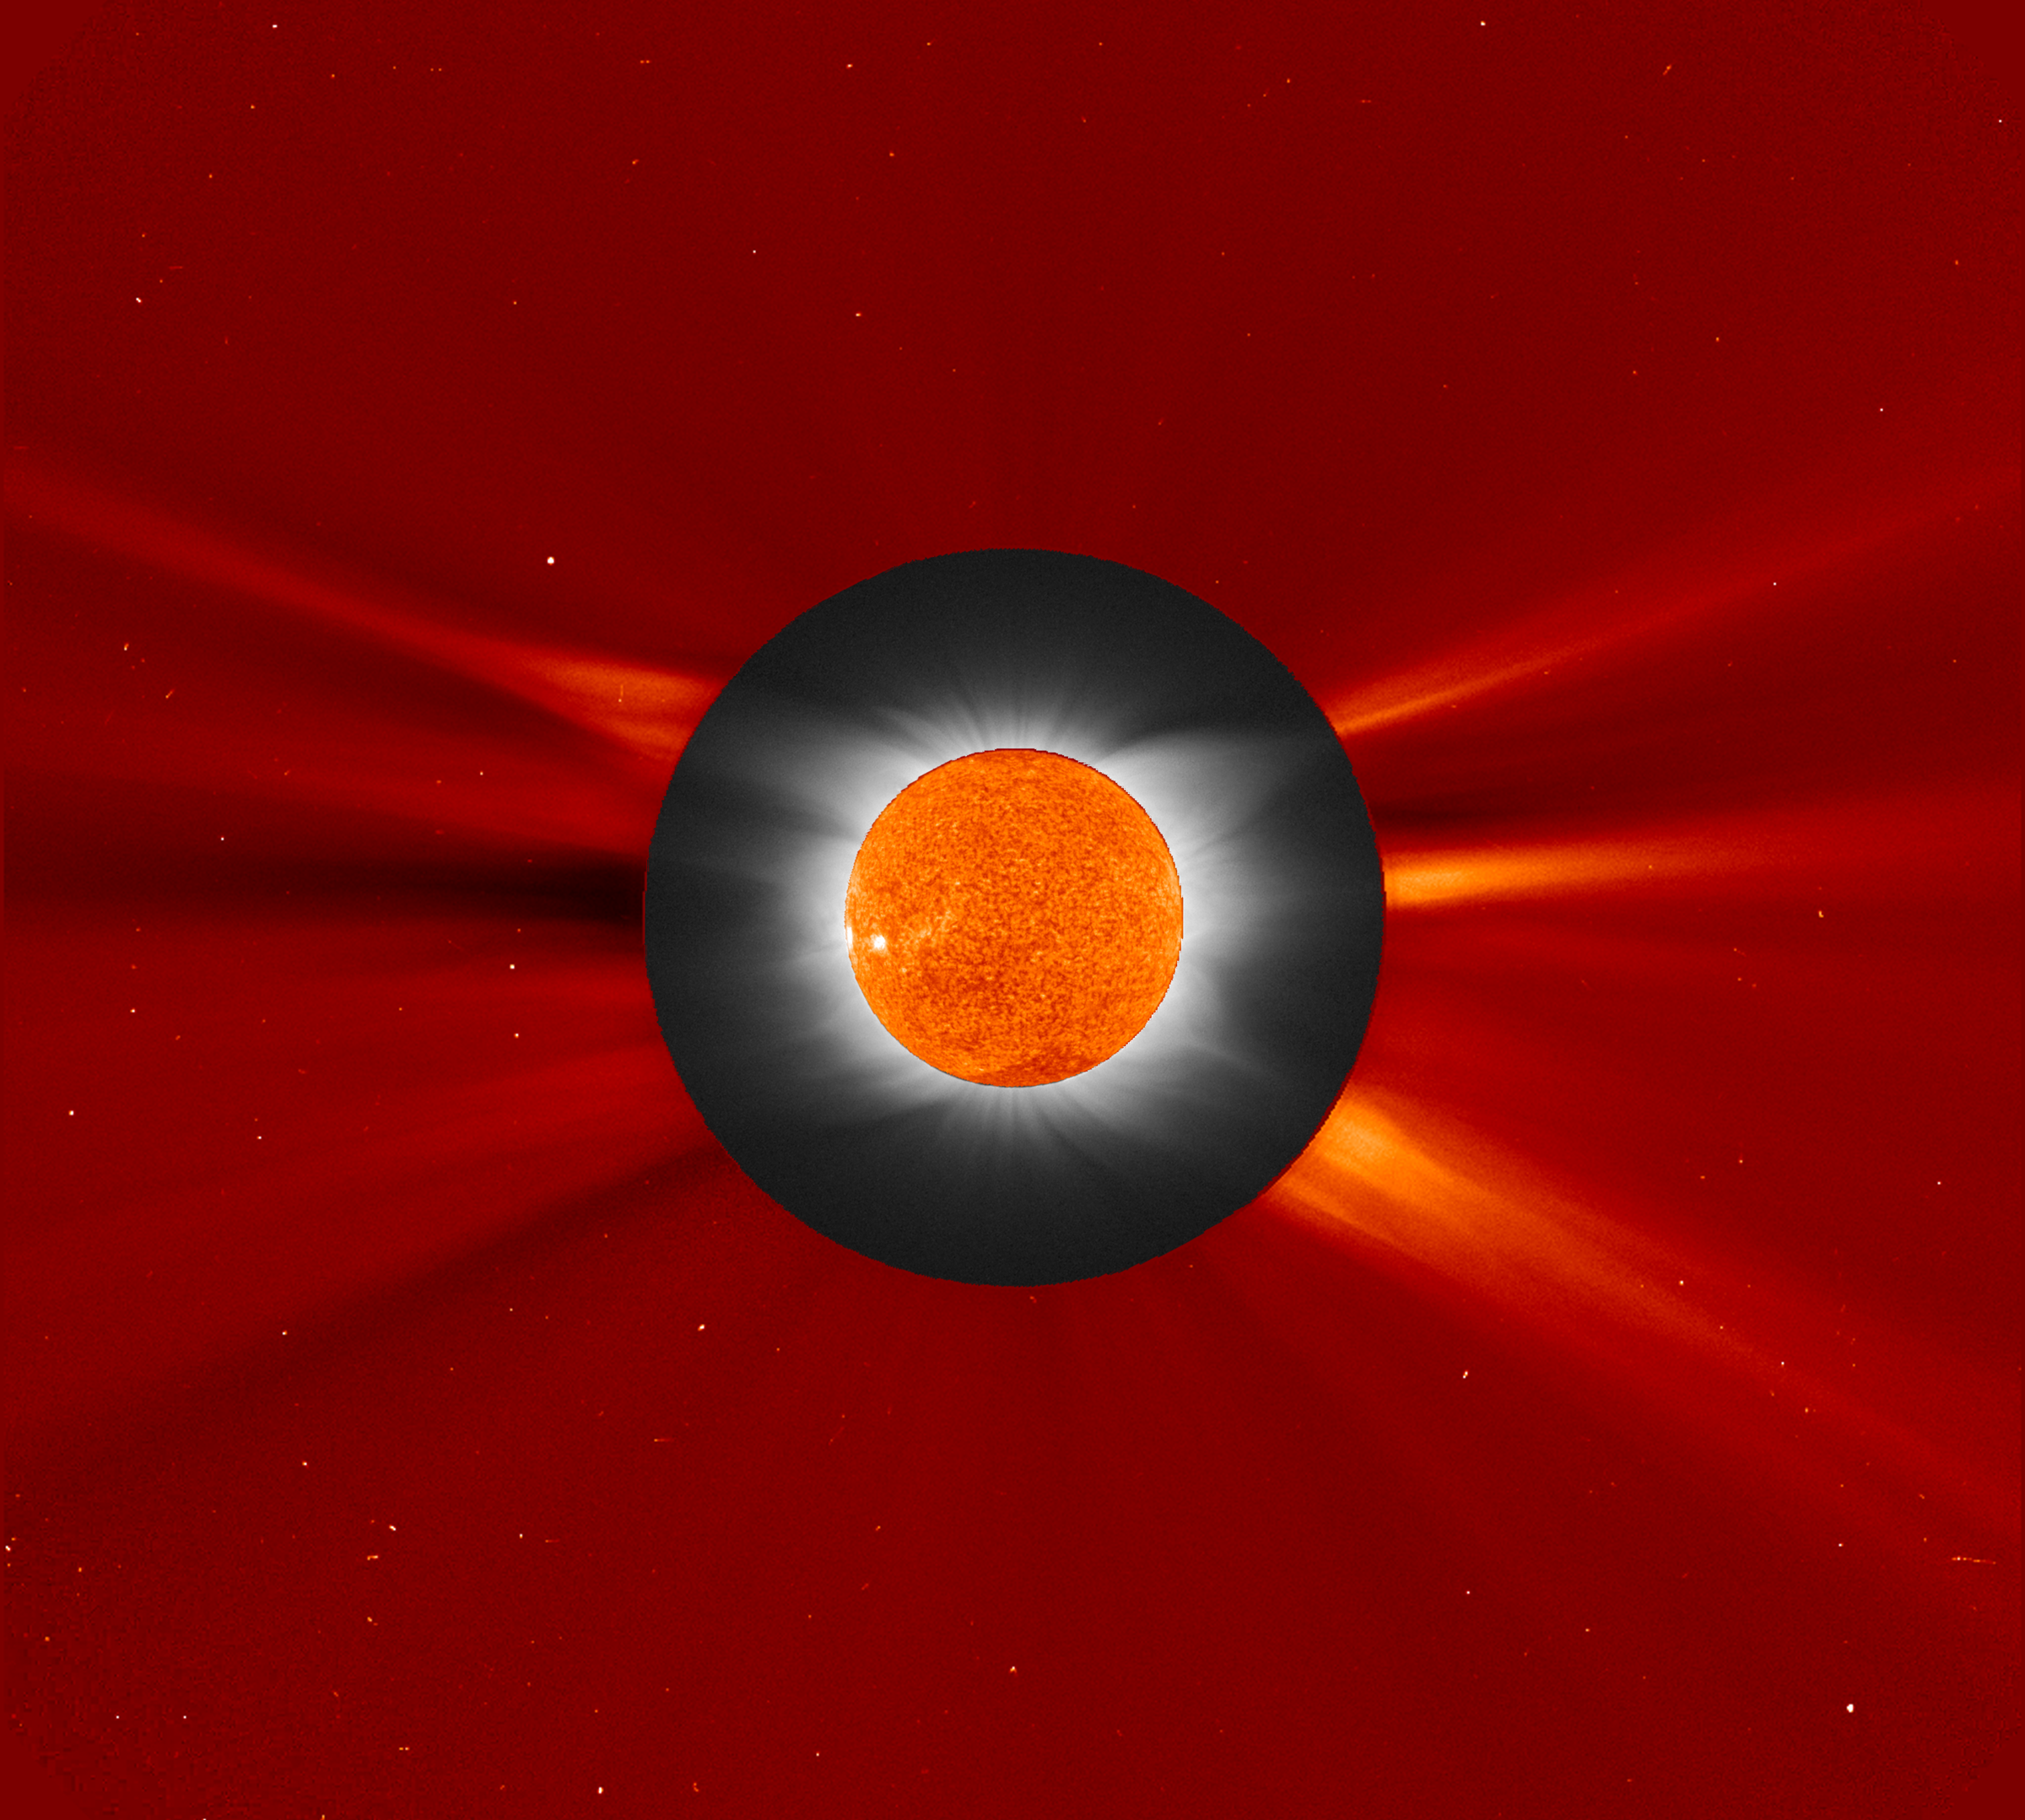
From Ground: see inner corona
© Gerard Williger 2023 U Louisville
Occulting disks (metal circles to block Sun’s disk to study the corona) on satellites have to cover more than the Sun’s disk to reduce scattered light in their optical system
Natural eclipse on ground lets us see inner regions of corona better
SOHO satellite ground
Williams College Eclipse Expedition, 2006 Mar 29, Jay Pasachoff et al., https://soho.nascom.nasa.gov/hotshots/2006_03_29/

Slide 23
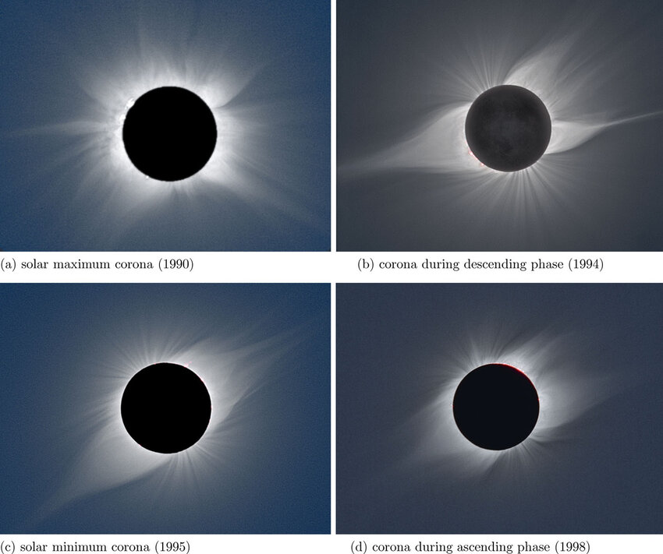
From Ground: corona vs solar cycle
© Gerard Williger 2023 U Louisville
Corona at “solar maximum” (maximum sunspots) has streamers in all directions
Corona at “solar minimum” (minimum sunspots) has streamers mostly from Sun’s equator
Also possible to see changes in older historical drawings, photos
1990, solar max
1994, decreasing
1995, solar min
1998, increasing

Slide 24
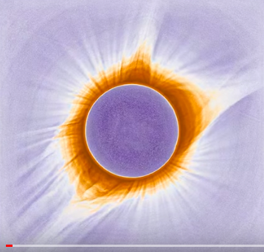
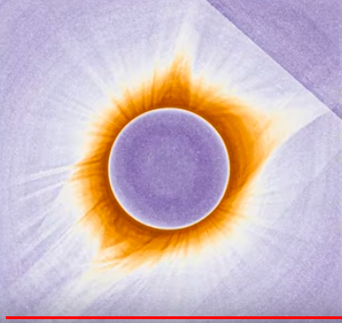
From Ground: corona motions
© Gerard Williger 2023 U Louisville
Megamovie, Aug 21, 2017, Oregon, 1:18pm EDT
Megamovie, Aug 21, 2017, South Carolina, 2:37pm EDT
2’ video: Megamovie 1.1
Coronal material can move 36000 km/h = 22,000 mph → 2.5% of Sun’s disk in an hour

Slide 25
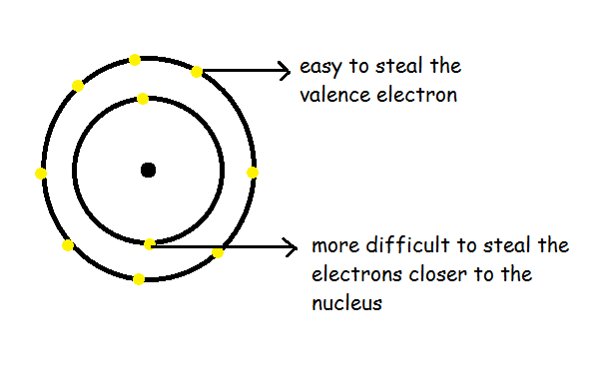
Key Concept: Ionization
Ionization: process of an atom losing one or more electrons
© Gerard Williger 2023 U Louisville
HOW? Can happen with when
an energetic enough photon (light particle) hits an atom OR
when a fast enough moving particle (electron) hits it
So atoms missing lots of atoms (“highly ionized”) – associated with HIGH TEMPERATURES

Slide 26
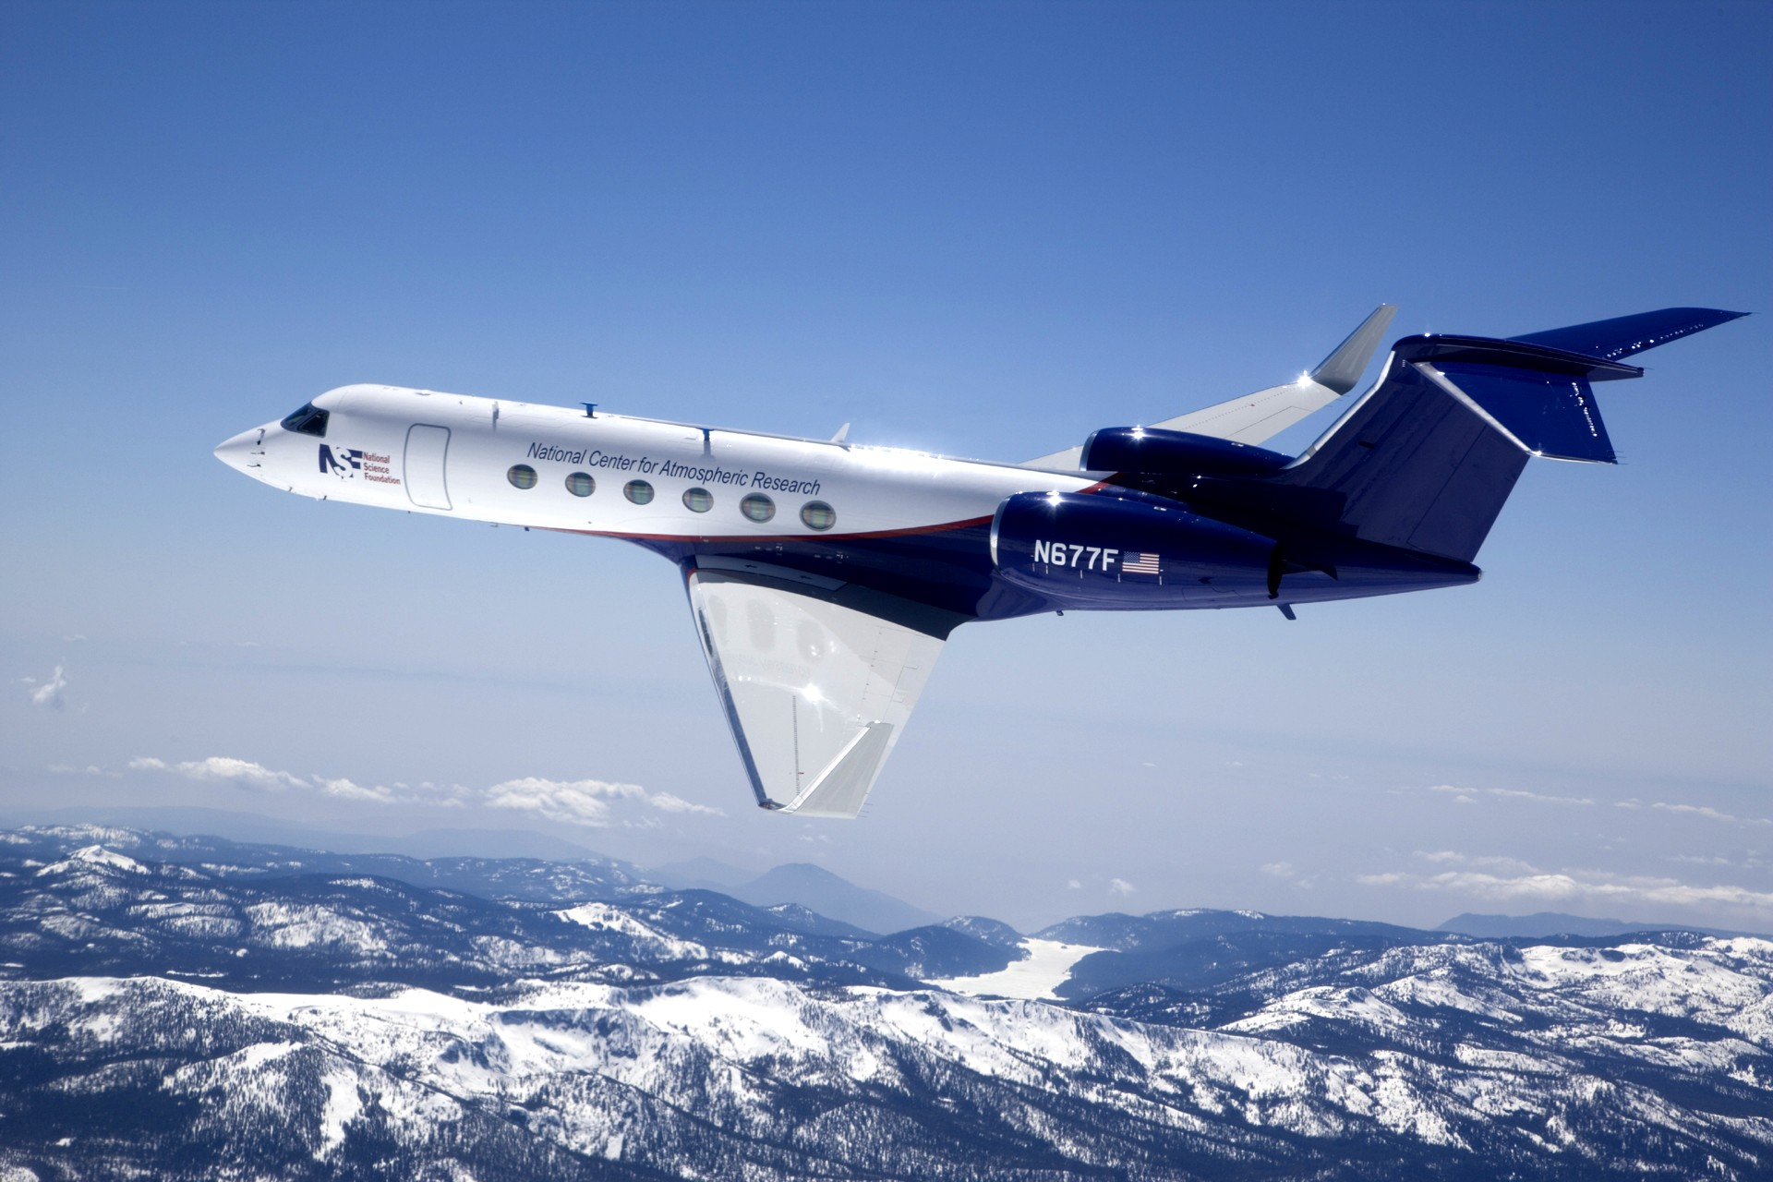
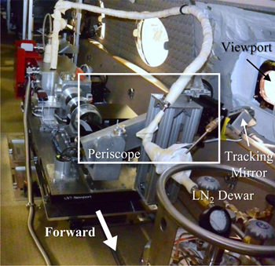
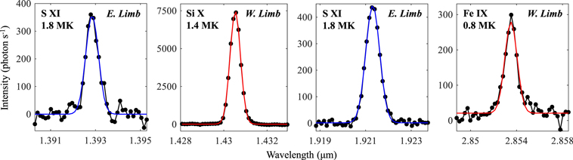
From Airplane: infrared observations
AIR-Spec (Airborne Infrared Spectrometer), from Samra et al. (2022), Astrophys J, 933, 82, for July 2, 2019 eclipse over South Pacific
© Gerard Williger 2023 U Louisville
Gulfstream V, Nat’l Ctr for Atmospheric Research
12” VIDEO
Observes at 12km = 7.5 miles altitude
Note high coronal temperatures!
silicon, 9x ionized
sulfur, 10x ionized
iron, 8x ionized
sulfur, 10x ionized

Slide 27
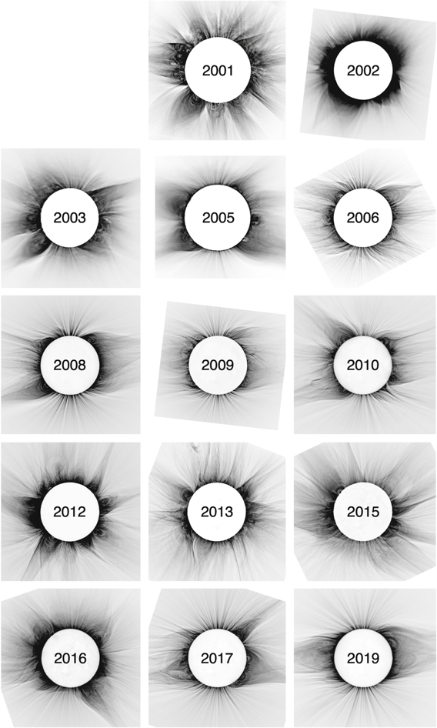
From Ground: magnetic fields
© Gerard Williger 2023 U Louisville
Change of corona with sunspot cycle -- influenced by magnetic fields
Eclipse observations of fine structures in corona
reveal shape of coronal magnetic field in higher detail and over larger area than ever (Boe et al. 2020, Astrophys J, 895, 123)
Visible light eclipse images

Slide 28
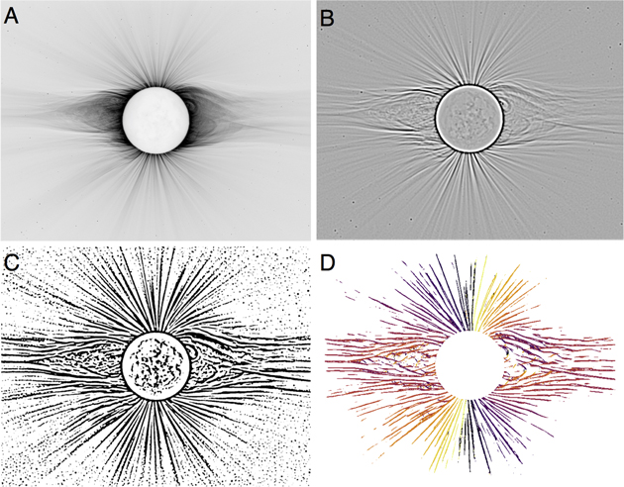
Technique: corona image → magnetic field
Line tracing technique from Boe et al. (2020), originally used to trace Milky Way Galaxy’s magnetic field.
A) Large features filtered out
B) Image then blurred
C) Converted to black and white
D) Algorithm run to measure angle for each pixel, color-coded
Visible light
© Gerard Williger 2023 U Louisville

Slide 29
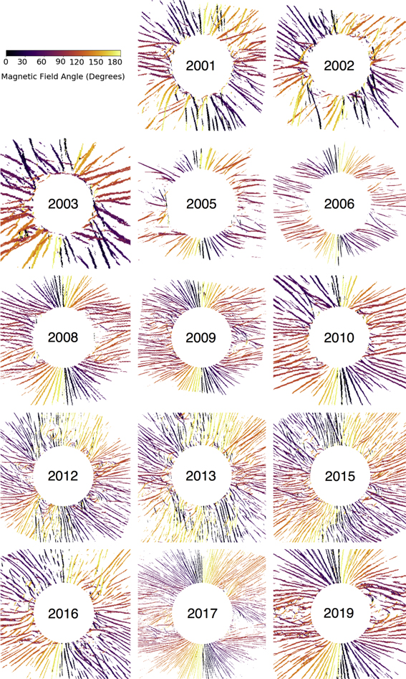
Magnetic Field changes, 2001-19
© Gerard Williger 2023 U Louisville
Visible light
Magnetic fields
Boe et al. (2020)

Slide 30
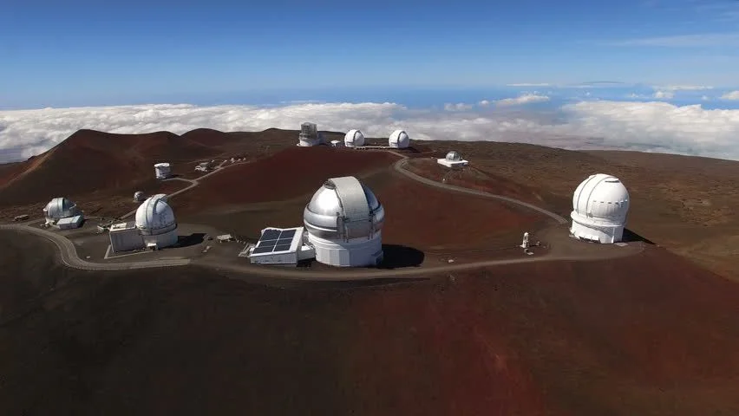
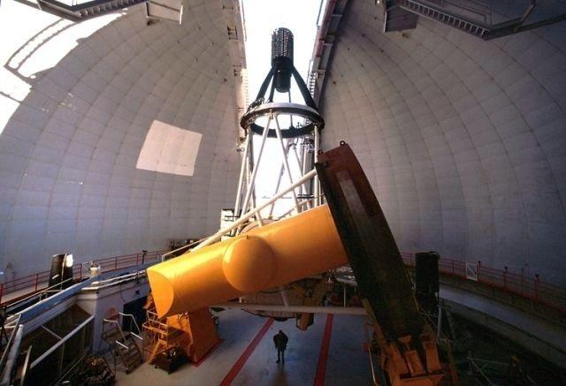
From Ground: high resolution images
© Gerard Williger 2023 U Louisville
CFHT
July 11, 1991 eclipse passed right over Mauna Kea, Hawaii – home to many of the world’s biggest telescopes!
High resolution, fast exposure images taken with 3.6m (11.9’) diameter Canada-France-Hawaii Telescope (CFHT)
Mauna Kea, Hawaii
CFHT

Slide 31
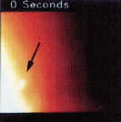
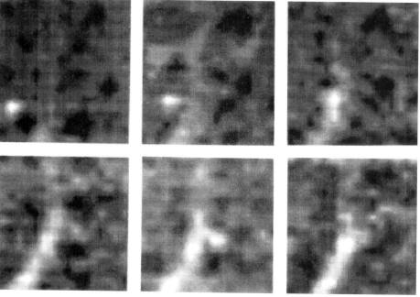
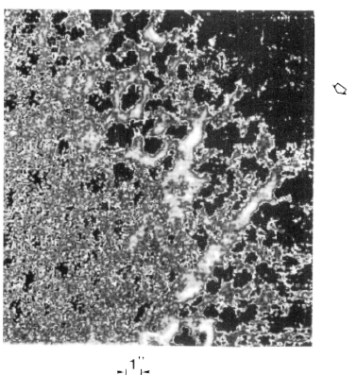
1991 CFHT Observations
© Gerard Williger 2023 U Louisville
Koutchmy et al. (1994, Astron. & Astrophys., 281, 249) found smallest coronal feature ever recorded (0.4 arcsec → 290 km = 180 miles)
Processed images
1 raw image
Images taken every 30 seconds
Filtered, combined image – see coronal thread

Slide 32
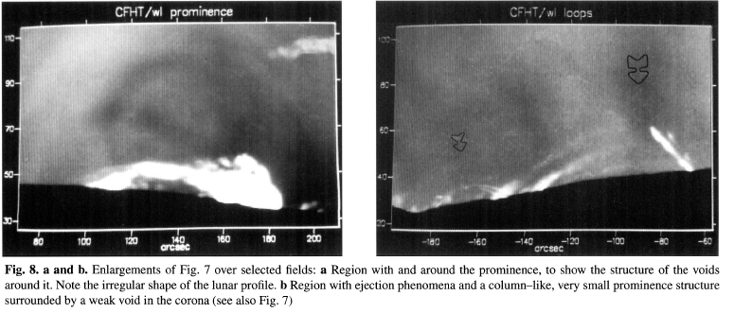
Fine Structure in Prominences
© Gerard Williger 2023 U Louisville
Koutchmy et al. (1994)
29000 km =
18000 miles
29000 km =
18000 miles

Slide 33
SUMMARY
© Gerard Williger 2023 U Louisville
Eclipses have provided major scientific discoveries in the past
Discovery of the corona
Discovery of helium
Verification of general relativity
Changes in Earth’s rotation
On-going analysis of historical records!
Science today still reveals much
Studies of inner corona
Changes over time and with solar cycle
Motions in corona
Infrared observations
Magnetic fields
Fine structure in corona, prominences

